Slide 1

Introduction
CS 2321
Data Structures and Algorithms
Dr. Mahmoud Hassaballah

Slide 2
Outlines
Introduction
Mathematics Review
Exponents
Logarithms
Series
Modular Arithmetic
Recursion
Pointers and Arrays

Slide 3
1. Introduction
Reading: Textbook (Weiss) 1.1

Slide 4
Objectives
We will:
See that how a program performs for reasonably large input is just as important as its performance on moderate amount of input.
Summarize the basic mathematical background needed for the rest of the course.
Briefly review recursion, pointers and arrays.

Slide 5

Introduction
Selection Problem: Given a group of N numbers, determine the k^{th} largest number, where $N≥k$.
Solution 1:
(1) read N numbers into an array,
(2) sort the array in decreasing order by some simple algorithm (e.g., bubble sort),
(3) return the element in position k.
Solution 2:
(1) read the first k elements into an array and sort them in decreasing order,
(2) each remaining element is read one by one,
(2.1) If it is smaller than the k^{th} element in the array, it is ignored;
(2.2) Otherwise, it is placed in its correct spot in the array, bumping one element out of the array.
(3) the element in the k^{th} position is returned as the answer

Slide 6
Introduction
The natural questions, then, are: Which algorithm is better? And, more important, Is either algorithm good enough?
A simulation using a random file of 30 million elements and k = 15,000,000 will show that neither algorithm finishes in a reasonable amount of time; each requires several days of computer processing to terminate.
An alternative method, discussed in Chapter 2, gives a solution in about a second.

Slide 7
2. Mathematical Review
Reading: Textbook (Weiss) 1.2

Slide 8
Exponents
In this section we list some of the basic formulas we need to be able to derive and reviews basic proof techniques.

Slide 9
Logarithms
In computer science, all logarithms are to the base 2 unless specified otherwise.
Definition: X^{A} = B if and only if log_{X} B = A.
Examples, log₃ 9 = 2, log 1 = 0, log 2 = 1, and log 1024 = 10.
log = log₂ and ln = log_{e}
Theorem:

Slide 10
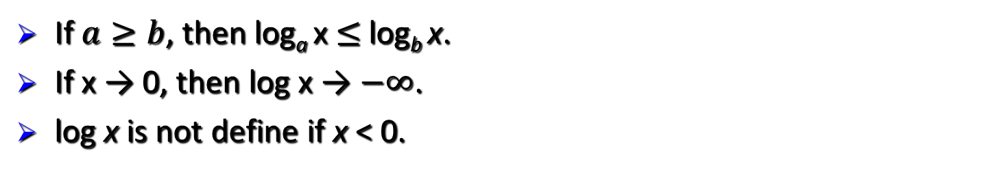
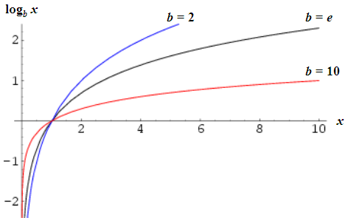
Logarithms
If $a≥b$, then log_{a} x $≤$log_{b} x.
If x → 0, then log x → $−∞$.
log x is not define if x < 0.

Slide 11

Series
If 0 < A < 1, then
If N → $∞$, and 0<A<1 then
Geometric Series
For example:

Slide 12
Series
Arithmetic Series
Note That:
Example: To find the summation
2+5+8+….+ (3k-1)
= 3(1+2+3+…+k)
- (1+1+1+….+1)

Slide 13
Recursion
Reading: Textbook (Weiss) 1.3

Slide 14
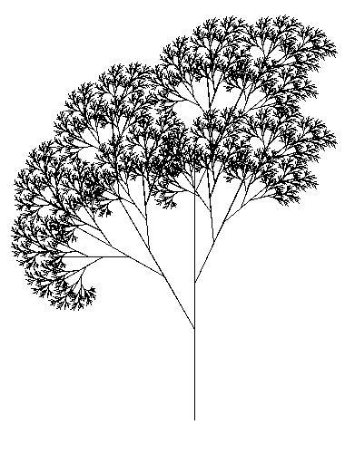
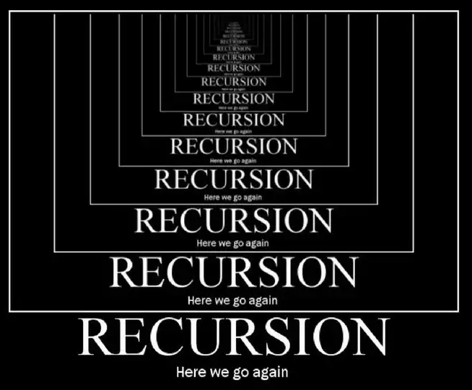
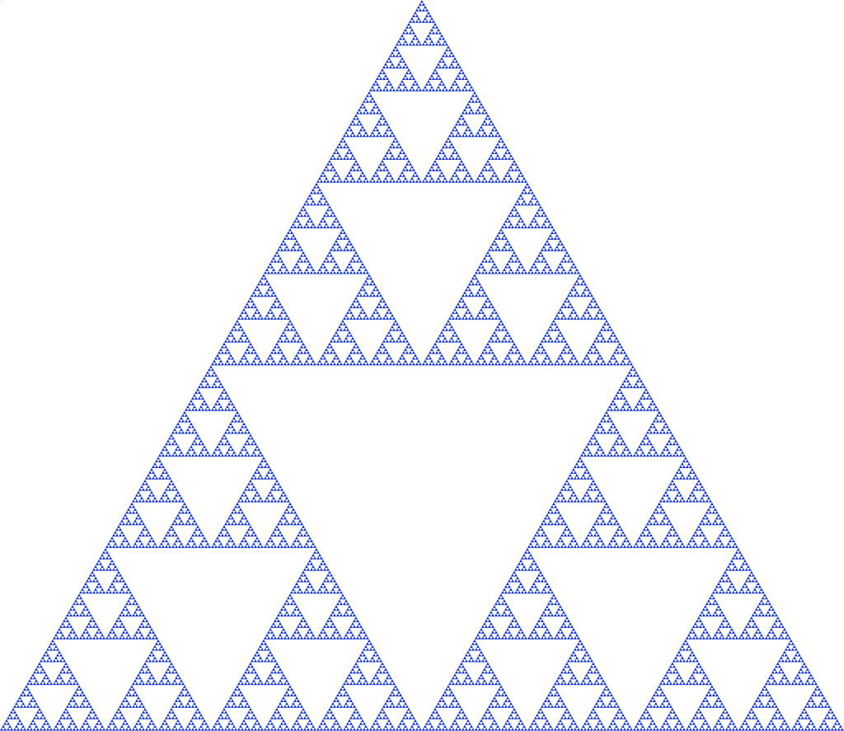
Recursion

Slide 15
Recursion
A function that is defined in terms of itself is called recursive.
For example, the factorial
Characteristics of a recursive definition
- It has a stopping point (base case).
- It (recursively) allows evaluation of an expression involving a variable n from a higher value to a lower value of n.

Slide 16
Recursion
Final value = 120
5!
5!
5! = 5 * 24 = 120 is returned
5 * 4!
5 * 4!
4! = 4 * 6 = 24 is returned
4 * 3!
4 * 3!
3! = 3 * 2 = 6 is returned
3 * 2!
3 * 2!
2! = 2 * 1 = 2 is returned
2 * 1!
2 * 1!
1 returned
1
1
(a) Sequence of recursive calls.
(b) Values returned from each recursive call.

Slide 17

Factorial n
Iterative algorithm
Recursive algorithm

Slide 18
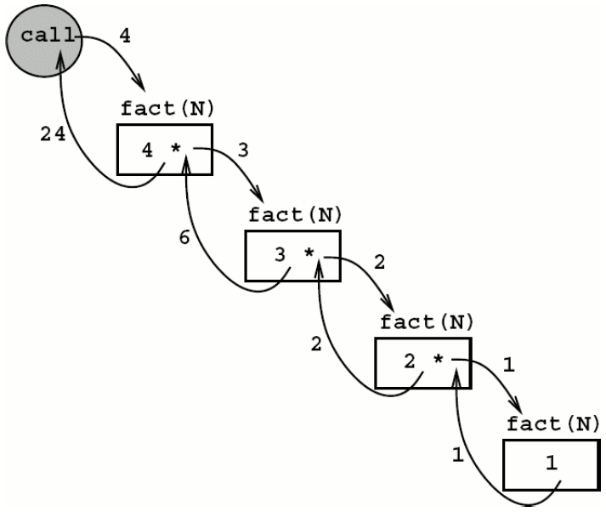
Factorial n
Recursive process

Slide 19
Fibonacci numbers
F_{i} = F_{i-1} + F_{i-2} for i > 1 where F₀ = 0, F₁ = 1.
Using recursion
fib (int n)
{
int x, y;
if (n <= 1)
return (n);
else
{
x = fib (n - 1);
y = fib (n - 2);
return (x + y);
}
}
Using iterative
if (n <= 1)
return (n);
lofib = 0;
hifib = 1;
for (i=2; i<=n; i++)
{
x = lofib;
lofib = hifib;
hifib = x + lofib;
}
return (hifib);

Slide 20
Recursion
Four Basic Rules of Recursion:
(1) Base cases: You must always have some base cases, which can be solved without recursion.
(2) Making progress: For the cases that are to be solved recursively, the recursive call must always be to a case that makes progress toward a base case.
(3) Design rule: Assume that all the recursive calls work.
(4) Compound interest rule: Never duplicate work by solving the same instance of a problem in separate recursive calls (i.e., it is a bad idea to use recursion to evaluate Fibonacci numbers).

Slide 21
Recursion
1 void printOut( int n ) // Print nonnegative n
2 {
3 if( n >= 10 )
4 printOut( n / 10 );
5 printDigit( n % 10 );
6 }
Recursive routine to print an integer

Slide 22
Recursion
Recursive process
Recursive definition defines an object in terms of a simpler case of itself.
Iterative process
Iterative evaluation calls for explicit repetition of similar computations. Such computations can generally be carried out in a for loop operation.

Slide 23
Recursion
Every recursive solution has a corresponding iterative solution.
For some problems recursive solutions are often more simple and elegant than iterative solutions.
You must be able to determine when recursion is the correct technique to use.

Slide 24
Pointer and Arrays
Reading: Textbook (Weiss) 1.5

Slide 25
Pointer and Arrays
Pointer variables:
Contain memory addresses as their values
Normal variables contain a specific value (direct reference)
Pointers contain address of a variable that has a specific value (indirect reference)
count
countPtr
count
7
7

Slide 26
Pointer and Arrays
Pointer definitions:
* used with pointer variables
int *myPtr;
Defines a pointer to an int (pointer of type int *)
Multiple pointers require using a * before each variable definition
int *myPtr1, *myPtr2;
Can define pointers to any data type
Initialize pointers to 0, NULL, or an address
0 or NULL – points to nothing (NULL preferred)

Slide 27
Pointer and Arrays
Address operator (&):
Returns address of operand
int y = 5;
int *yPtr;
yPtr = &y; /* yPtr gets address of y */
yPtr “points to” y
yptr
y
y
5
500000
600000
600000
5
yPtr
Address of y is value of yptr

Slide 28
Pointer and Arrays
Assume that array int v[5] has been defined and its first element is at location 3000 in memory in a machine with 4-byte integers. Also let vPtr is a pointer to v, i.e., vPtr = 3000.
vPtr += 2; sets vPtr to 3008
location
3000
3004
3008
3012
3016
v[0]
v[1]
v[2]
v[3]
v[4]
pointer variable vPtr
location
3000
3004
3008
3012
3016
v[0]
v[1]
v[2]
v[3]
v[4]
pointer variable vPtr

Slide 29
Pointer and Arrays
Arrays and pointers closely related
Array name like a constant pointer
Pointers can do array subscripting operations
Define an array b[ 5 ] and a pointer bPtr. To set them equal to one another use:
bPtr = b;
bPtr = &b[ 0 ]
Explicitly assigns bPtr to address of first element of b

Slide 30
Pointer and Arrays
Element b[ n ] can be accessed by:
- Pointer/subscript notation bptr[ n ].
Pointer/offset notation *( bPtr + n ) where n is called offset.
Pointer/offset notation where the pointer is the array name *( b + n ).

Slide 31
Pointer and Arrays
Arrays can contain pointers
For example: an array of strings
char *suit[ 4 ] = { "Hearts", "Diamonds", "Clubs", "Spades" };
Strings are pointers to the first character
char * – each element of suit is a pointer to a char
The strings are not actually stored in the array suit, only pointers to the strings are stored
suit array has a fixed size, but strings can be of any size
suit[0]
‘H’
‘e’
‘a’
‘r’
‘t’
‘s’
‘\0’
suit[1]
‘D’
‘i’
‘a’
‘m’
‘o’
‘n’
‘d’
‘s’
‘\0’
suit[2]
‘C’
‘l’
‘u’
‘b’
‘s’
‘\0’
suit[3]
‘S’
‘p’
‘a’
‘d’
‘e’
‘s’
‘\0’

Slide 32
Pointer and Arrays
C++ enables programmer to control the allocation and deallocation of memory in a program for any built-in or user-defined type.
This is known as dynamic memory management and is performed with operators new and delete.
The new operator automatically creates object of proper size, calls constructor, returns pointer of the correct type.
The delete operator destroys object and frees space

Slide 33
Pointer and Arrays
Example:
Consider the following declaration and statement:
TypeName *typeNamePtr;
typeNamePtr = new TypeName;
- creates pointer to a TypeName object
- new creates TypeName object, returns pointer (which typeNamePtr is set equal to)
The statement:
delete typeNamePtr;
calls destructor for TypeName object and frees memory

Slide 34
Pointer and Arrays
Initializer:
The following statement initializes object of type double to 3.14159
double *thingPtr = new double( 3.14159 );
To create ten element int array, assign to arrayPtr.
int *arrayPtr = new int[ 10 ];
To delete this arrays
delete [] arrayPtr;

